Slide 1
Organisational Behaviour
Topic: Politics
Dr. C. Vijaya Banu
Associate Professor , School of Management
SASTRA Deemed University, Thanjavur – 613 401
vijayabanu@mba.sastra.edu

Slide 2
Organizational Politics
Attempts to influence others using discretionary behaviors to promote personal objectives
Discretionary behaviors -- neither explicitly prescribed nor prohibited
Politics may be good or bad for the organization

Slide 3
Types of Organizational Politics
Managing
impressions
Attacking and
blaming
Types of
Organizational
Politics
Creating
obligations
Controlling
information
Cultivating
networks
Forming coalitions

Slide 4
Conditions for Organizational Politics
Personal
Characteristics
Scarce
Resources
Conditions
Supporting
Organizational
Politics
Complex and
Ambiguous
Decisions
Tolerance of
Politics

Slide 5
Persuasive Communication
Communicator
Characteristics
• Expert
• Credibility
• Attractive
Communication Medium
Audience
Characteristics
• Self-esteem
• Inoculated
Message
Content
• Present all sides
• Few arguments
• Emotional appeals
• Inoculation effect

Slide 6
Politics Is in the Eye of the Beholder
“Political” Label “Effective Management” Label
1. Blaming others vs. Fixing responsibility
2. “Kissing up” vs. Developing working relationships
3. Apple polishing vs. Demonstrating loyalty
4. Passing the buck vs. Delegating authority
5. Covering your rear vs. Documenting decisions
6. Creating conflict vs. Encouraging change and innovation
7. Forming coalitions vs. Facilitating teamwork
8. Whistle blowing vs. Improving efficiency
9. Scheming vs. Planning ahead
10. Overachieving vs. Competent and capable
11. Ambitious vs. Career-minded
12. Opportunistic vs. Astute
13. Cunning vs. Practical-minded
14. Arrogant vs. Confident
15. Perfectionist vs. Attentive to detail
Source: Based on T. C. Krell, M. E. Mendenhall, and J. Sendry, “Doing Research in the Conceptual Morass of Organizational Politics,” paper presented at the Western Academy of Management Conference, Hollywood, CA, April 1987.

Slide 7
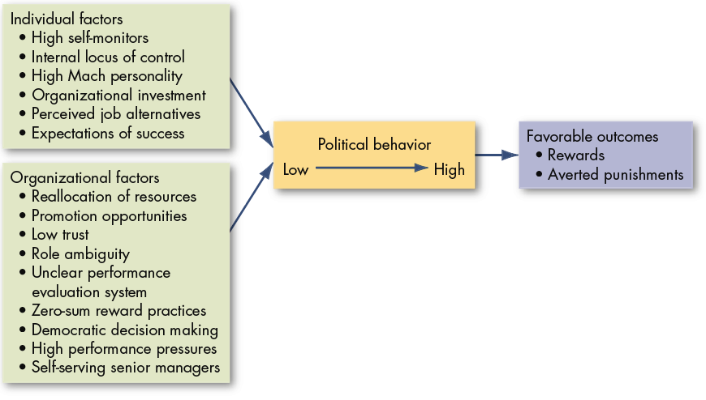
Factors That Influence Political Behaviors

Slide 8
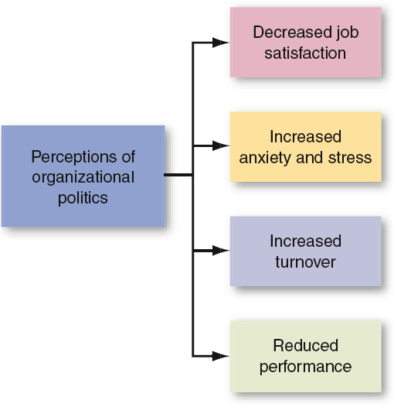
Employee Responses to Organizational Politics

Slide 9
Defensive Behaviors
Avoiding Action:
Over conforming
Buck passing
Playing dumb
Stretching
Stalling
Avoiding Blame:
Buffing
Playing safe
Justifying
Scapegoating
Misrepresenting
Avoiding Change:
Prevention
Self-protection

Slide 10
Impression Management (IM)
Impression Management
The process by which individuals attempt to control the impression others form of them.
IM Techniques:
Conformity
Excuses
Apologies
Self-Promotion
Flattery
Favors
Association
Source: Based on B. R. Schlenker, Impression Management (Monterey, CA: Brooks/Cole, 1980); W. L. Gardner and M. J. Martinko, “Impression Management in Organizations,” Journal of Management, June 1988, p. 332; and R. B. Cialdini, “Indirect Tactics of Image Management Beyond Basking,” in R. A. Giacalone and P. Rosenfeld (eds.), Impression Management in the Organization (Hillsdale, NJ: Lawrence Erlbaum Associates, 1989), pp. 45–71.

Slide 11
Is A Political Action or behavior Ethical?

Slide 12
When you go to work, what three things can you do avoid politics?

Slide 13
Controlling Political Behavior
Provide
Sufficient
Resources
Remove
Political Norms
Introduce
Clear Rules
Hire
Low-Politics
Employees
Free Flowing
Information
Increase
Opportunities
for Dialogue
Manage Change
Effectively
Peer Pressure
Against Politics
Video link : https://youtu.be/l8iMvD47VNg

